Slide 1

The human : I/O Channel
Vision
Hearing
Touch
Movement

Slide 2
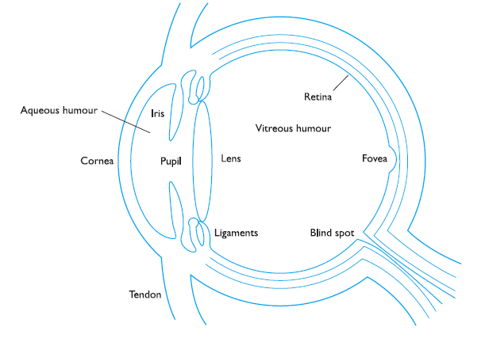
Human vision
Two stages in vision
• physical reception of stimulus
• processing and interpretation of stimulus

Slide 3
The Eye - physical reception
mechanism for receiving light and transforming it into electrical energy
light reflects from objects images are focused upside-down on retina
retina contains rods for low light vision and cones for colour vision
120 millions of rods, 6 millions of cones
Rods are highly sensitive to light - low level of illumination
less sensitive to light – tolerate more light
ganglion cells (brain!) detect pattern and movement

Slide 4
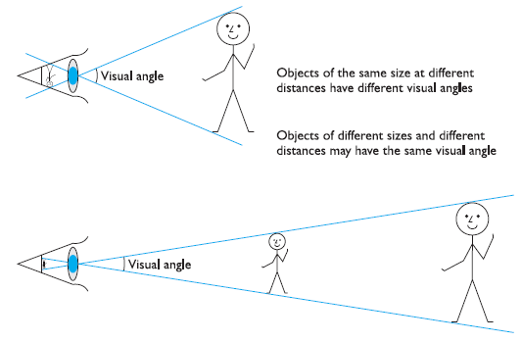
Interpreting the signal
Size and depth
visual angle indicates how much of view object occupies (relates to size and distance from eye)
visual acuity is ability to perceive detail (limited)
familiar objects perceived as constant size (in spite of changes in visual angle when far away)
cues like overlapping help perception of size and depth

Slide 5
Interpreting the signal (cont)
Brightness
subjective reaction to levels of light
affected by luminance of object
measured by just noticeable difference
visual acuity increases with luminance as does flicker
Colour
made up of hue, intensity, saturation
Hue made of wavelength of light - Blues have short wavelengths, greens medium and reds long.
cones sensitive to colour wavelengths
blue acuity is lowest
8% males and 1% females colour blind
unable to discriminate between red and green.

Slide 6


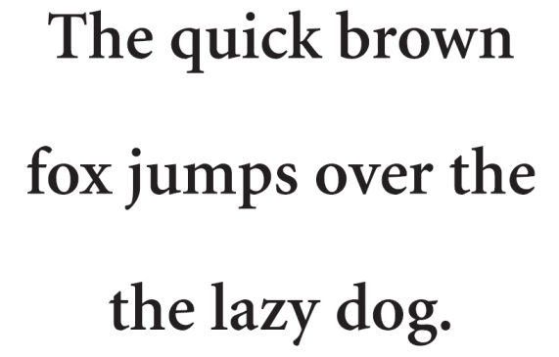
Interpreting the signal (cont)
The visual system compensates for:
movement
changes in luminance.
Context is used to resolve ambiguity
Optical illusions sometimes occur due to over compensation

Slide 7
Optical Illusions
“These illusion demonstrate that our perception of size is not completely reliable”
the Ponzo illusion
the Muller-Lyer illusion
Which line is longer

Slide 8

Reading
Several stages:
visual pattern perceived
decoded using internal representation of language
interpreted using knowledge of syntax, semantics, pragmatics
Reading involves saccades and fixations
Adults read approximately 250 words a minute
font sizes of 9 to 12 points are equally legible
Perception occurs during fixations

Slide 9
Reading
In design Focus:
Word shape is important to recognition
Negative contrast improves reading from computer screen
negative contrast (dark characters on a light screen) provides higher luminance

Slide 10
2.Hearing
Provides information about environment: distances, directions, objects etc.
Physical apparatus:
outer ear – protects inner and amplifies sound
middle ear – transmits sound waves as vibrations to inner ear
inner ear – chemical transmitters are released and cause impulses in auditory nerve
Sound
pitch – sound frequency
loudness – amplitude
timbre – type or quality
Design Focus : warning sound, notification, multimedia, System state

Slide 11
Hearing (cont)
Humans can hear frequencies from 20Hz to 15kHz
less accurate distinguishing high frequencies than low.
Auditory system filters sounds
can attend to sounds over background noise.
for example, the cocktail party phenomenon.

Slide 12


3.Touch
Provides important feedback about environment.
May be key sense for someone who is visually impaired.
Stimulus received via receptors in the skin:
Thermoreceptors – heat and cold
Nociceptors – pain
Mechanoreceptors – pressure (some instant, some continuous)
Some areas more sensitive than others e.g. fingers.
Kinethesis - awareness of body position
affects comfort and performance.

Slide 13
4.Movement
Time taken to respond to stimulus: reaction time + movement time
Movement time dependent on age, fitness etc.
Reaction time - dependent on stimulus type:
visual ~ 200ms
auditory ~ 150 ms
pain ~ 700ms
Increasing reaction time decreases accuracy in the unskilled operator but not in the skilled operator.

Slide 14
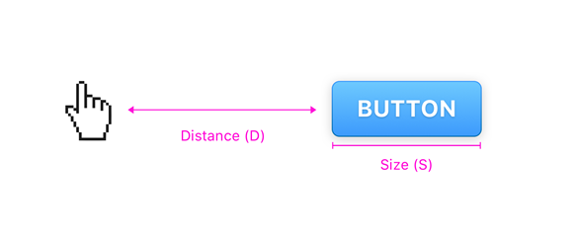
Movement (cont)
Fitts' Law describes the time taken to hit a screen target:
amount of time required for a person to move a pointer (e.g., mouse cursor) to a target area is a function of the distance to the target divided by the size of the target.
Mt = a + b log₂(D/S + 1)
where: a and b are empirically determined constants
Mt is movement time
D is Distance
S is Size of target

Slide 15
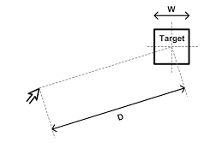

Movement (cont)
targets as large as possible, distances as small as possible
In design Focus: Most frequently used option can be placed closest to the user’s start point in the menu list

Slide 16
Design focus
Piechart- shaped menus are preferable to lists since all options are equidistant.
If lists are used, the most frequently used options can be placed closest to the user’s start point

Slide 17
Human Memory
Sensory memory
Short term memory
Long term memory

Slide 18
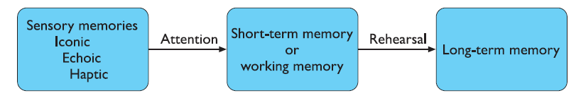
Memory

Slide 19

Sensory memory
It act as “buffers” for stimuli received through senses
A sensory memory exists for each sensory channel
iconic memory: visual stimulus
echoic memory: acoustic stimulus
haptic memory: touch stimulus
Continuously overwritten by new information coming from these channels
Examples
Iconic memory: At firework displays where moving “sparklers” leave a persistence image, 0.5 sec
Echoic memory: brief “play back” of information

Slide 20
Sensory memory
Information is passed from sensory memory into short-term memory by attention
Attention is the concentration of the mind on one out of a number of competing stimuli or thoughts
It is clear we are able to focus our attention to one thing at a time
This is due to the limited capacity of our sensory memory
Otherwise overloaded

Slide 21
Sensory memory
We can choose which stimuli to attend to, and this choice is our level of interest or need
This explains the “cocktail party phenomenon”
“We can attend to one conversation over the background noise, but we may choose to switch our attention to a conversation across the room if we here our name mentioned”
Information received by sensory memories is quickly passed into more permanent or overwritten and lost

Slide 22
Short-term memory (STM)
It act as a “Scratch-pad” for temporary recall of information
Examples:
Calculate the multiplication 35x6 in your head
Comprehensive test
rapid access ~ 70ms
rapid decay ~ 200ms

Slide 23
Short-term memory (STM)
STM also has limited capacity- 7± 2 chunks
There are two methods for measuring memory capacity
Recall the sequence in order
Recall the sequence in any order

Slide 24
Try this!
212348278493202
21 234 8278 49320

Slide 25
Short-term memory (STM)
The successful formation of a chunk is known as “closure”
In Design Focus: Cashing in
ATM machine

Slide 26
Short Term Memory (STM):
In design Focus: 7± 2 revisited
List, menu and groups of items should be no more than 7 items long
Command line interfaces

Slide 27
Try this!
Patterns can be useful as aids to memory
HEC ATR ANU PTH ETR EET
The sequence is easy to recall (the cat ran up the tree)

Slide 28
Short-term memory (STM): The “recency effect”
Recall of the last words presented is better than recall of those in the middle.
This is known as the “recency effect”

Slide 29
Long-term memory (LTM)
Repository for all our knowledge
slow access ~ 1/10 second
slow decay, if any
huge or unlimited capacity
Long-term memory is intended for the long-term storage of information

Slide 30
The human
There are three main activities in LTM
Storage or remembering of information
Forgetting
Information retrieval

Slide 31
LTM - Storage
Information is placed in LTM from STM (working memory) though “rehearsal”
This process can be optimized in a number of ways

Slide 32
LTM - Storage
Ebbinghaus performed numerous experiments on memory, using himself as a subject.
He discovered that “amount learned was directly proportional to the amount of time spent in learning”
this is known as total time hypothesis
“amount retained proportional to rehearsal time”

Slide 33
LTM - Storage
Baddeley and others suggest that learning time is most effective if it is distributed over time.
This is known as distribution of practice effect
optimized by spreading learning over time
However, rehearsal is not enough to learn information well.
If the information is not meaningful it is more difficult to remember

Slide 34
Try this!
List A:
Faith, Logic, Value, Large, Age, Path, Magic, Success, Huge, Precision

Slide 35
Try this!
List B:
Boat, Tree, Toy, Pen, Plate, Lamp, Wood, Cycle, Table, Clock

Slide 36
Tips-for Learning
Structure, meaning and familiarity
information easier to remember if it follows the above

Slide 37
LTM - Forgetting
There are two main theories of forgetting
Decay and interference
Decay
Information held in LTM may eventually be forgotten
Information is lost gradually but very slowly
Jost’s law which follows from this, states that “if two memory traces are equally strong at a given time the older one will be more durable”

Slide 38
LTM - Forgetting
Interference
New information replaces old: retroactive interference
Old may interfere with new: proactive inhibition
Forgetting is also affected by emotional factors

Slide 39
LTM - Information retrieval
Recall
Information reproduced from memory
It can be assisted by cues, e.g. categories, imagery
Recognition
The presentation of information provides the knowledge that the information has been seen before
less complex than recall - information is cue

Slide 40
Tips to Improve your memory
1. bun
2. shoe
3. tree
4. door
5. hive
6. sticks
7. heaven
8. gate
9. wine
10. hen

Slide 41
Improve your memory (try to visualize it)
1. bun
2. shoe
3. tree
4. door
5. hive
6. sticks
7. heaven
8. gate
9. wine
10. hen

Slide 42
The model human processor (MHP) (card, moran and newell, 1983)
Model human as three interacting subsystems
Perceptual system
Cognitive system
Motor system

Slide 43
The model human processor

Slide 44
The biology of the model

Slide 45
The model human processor

Slide 46
Queries?

